Slide 1
Musicians as Athletes
Saba Kamal, OTR, CHT
Hands-On-Care

Slide 2
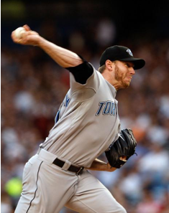
Athletes
Complex physical movements – to achieve end goal

Slide 3
Musicians
Playing music is using complex physical movements – to achieve goals
To carefully choreograph a piece
To achieve a Mind and Body connection
Requires Focus
To Anticipate movements / perfection through practice
Requires coordination of movement patterns and between players

Slide 4
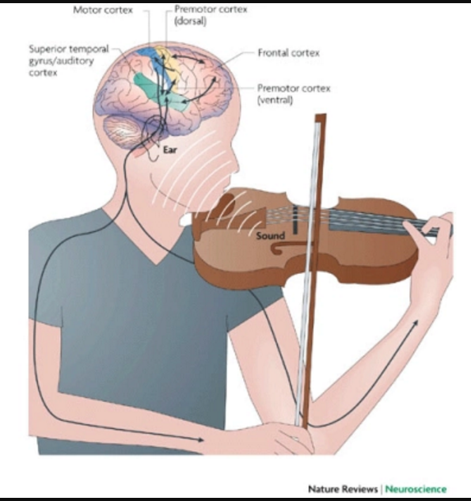
Science behind music
Applying science to train musicians
Musicians require physical fortitude and precision
Correct technique
Directed exercises
Flexibility
Maintain posture through long plays
Strength / endurance to carry instruments
Find coordination
Sound mind

Slide 5
Instruments
Own musical instruments
Comfort
Familiarity
Precision

Slide 6
Building Strength & performance endurance
We need the musician to be able to play music with
The right posture and technique for long duration. This requires core strength, so
Work on their proximal muscles,
However, for playing for long duration and avoiding fatigue requires endurance in the core muscles
This prevents injuries and technical challenges.
Endurance is directly proportional to Low Impact form

Slide 7
Ergonomics
Taping to correct posture to prevent injuries

Slide 8
RSI
Brain looses focus
Form deteriorates
Causes Strain due to fatigue
Leads to poor posture
Which results in improper technique
Resulting in repetitive stress injury

Slide 9
Brain exercise
Before playing
Visualization
Imagine sequence of the piece of music to be played
Motor imagery practice, mental practice, visualization
Imagining movements stimulates similar areas of brain activity as actual task performance, which may accompany recovery of motor function, thus resulting in reduced deficit [or disability]
20 healthy participants wore a plaster cast for 3 weeks on their non-dominant wrist/hand. One training session for imagery followed by HEP of visualization of movements 15 min/day and once weekly guided movement lead by a therapist.
• Differences noted for extension and ulnar deviation with moderate effects

Slide 10
Team work
Musicians coordinate
Every player is connected

Slide 11
Diet
Crucial for mental performance
Food for mental acuity
Preventing highs and lows or jittery effects
Improving muscle endurance

Slide 12
Training
New routines –
Small pieces
Go slow before picking up the pace
Easy rehearsals with taping for correct techniques
Timing pieces
Building up on time then pace and difficulty of music played

Slide 13
Musicians as athletes
Warm up
Timing / Training
The musician, after their stretching exercises/warm up, starts to play with the necessary tapes to keep them in check.
The musician times their instrument playing period, at the first sign of fatigue or pain the musician stops the timer and notates it.

Slide 14
Musicians as athletes
Timing / Training
Timing / Training
Next session they play the same piece but for less time than previously played, thus preventing any discomfort.
Once comfortable with the time/piece played, they slowly start to increase the time played again without discomfort and notate the time.

Slide 15
Musicians as athletes
Timing/ Training
Exercise program
Slowly but surely the time is increased with all the pieces in place until musician achieves the skill without breaking down.
They must continue working out and building postural muscles, endurance, and cardio (since a lot of musicians have a sedentary posture, cardio helps to keep the metabolism high which helps with healing).

Slide 16
Warm up
Assessment
Pre-warm ups flexibility exercises continue along with post stretching after playing.
If they do hurt after playing, first assess what went wrong so that they won’t repeat the technique and then apply ice to calm the irritation down.

Slide 17
Musicians as athletes
Next time, practice the same piece with taping to correct it, until perfected.

